Slide 1
CIS 553 Project 2 Group E
Ankit Mishra
Gouthaman Kumarappan
Simon Wimmer

Slide 2
Problem
Problem – DDoS attack mitigation
Distributed – Multiple attackers target a single victim node
Denial of Service – Attacker(s) send overwhelming number of ping requests (ping flood) and keep its resources tied
Result – The victim cannot service its intended users

Slide 3
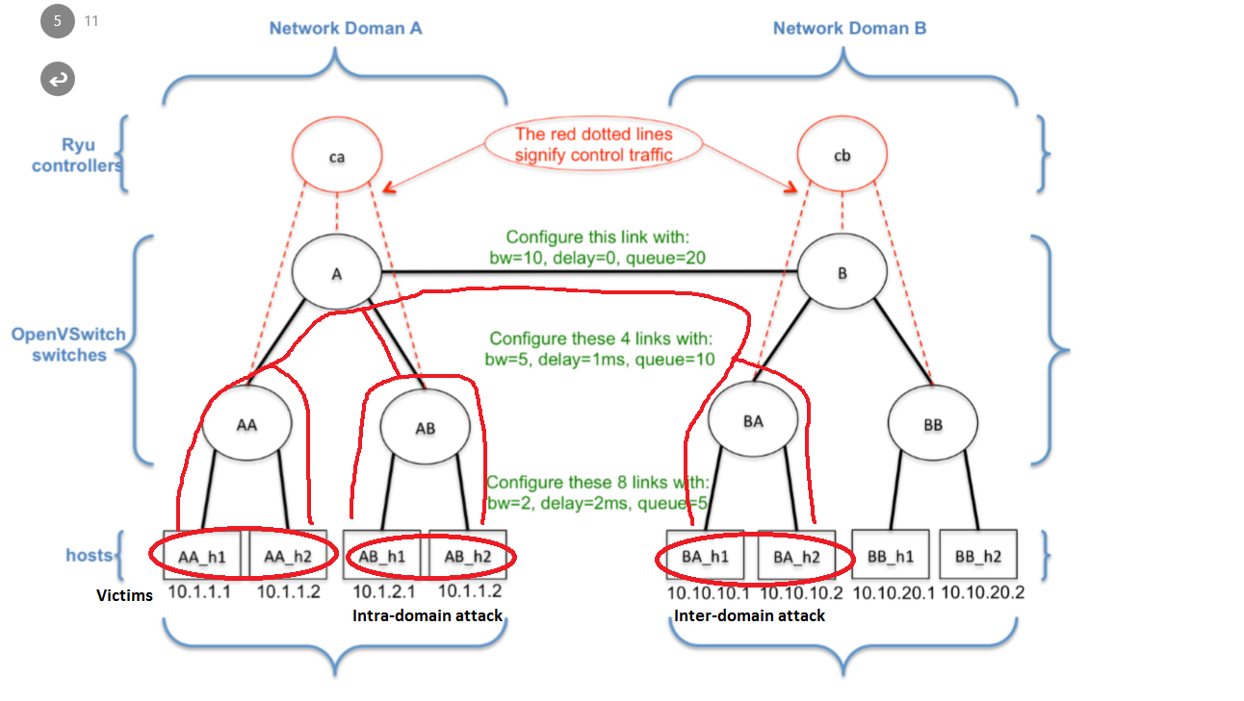
Topology and Attack Overview
BW : 5673 Kbps
BW : 7541Kbps
BW : 1958 Kbps

Slide 4
Solution Overview
Solution Stages –
Detect an attack
Identify the attacker
Attacker in same domain –> Apply Ingress on the port the attacker is connected
Attacker in another domain –> Send pushback request to the other domain
Respond to a pushback request (if detected)

Slide 5
Solution
Identify an Attack –
Controller A protects hosts AAh1 and AAh2 by monitoring flows on all 3 switches in its domain for high bandwidth (5 Mbps)
Identify an Attacker –
Check each host to check if it is sending data to the victim and its data rate is above a threshold (1 Mbps)

Slide 6
Solution
Intra domain attack –
Apply ingress policy on the link connecting the attacker to the domain
Inter domain attack –
Send a push back request to the other controller

Slide 7
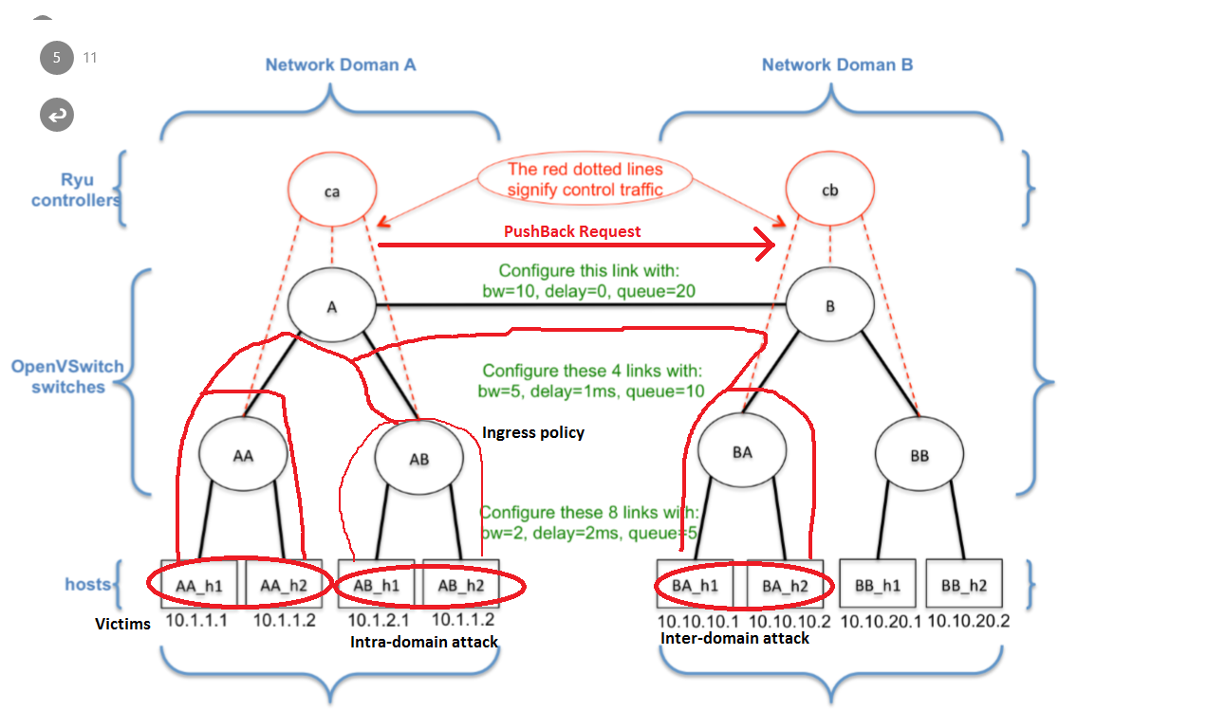
Solution – Intra-domain ingress + inter-domain pushback
BW : 5426 Kbps
BW : 5559 Kbps
BW : 61 Kbps

Slide 8
Solution
Respond to pushback –
Identify the attacker
Place an egress on the switch connecting attacker to the domain
Wait 10 seconds
Place an ingress at the link connecting the attacker to the domain and remove the egress policy

Slide 9
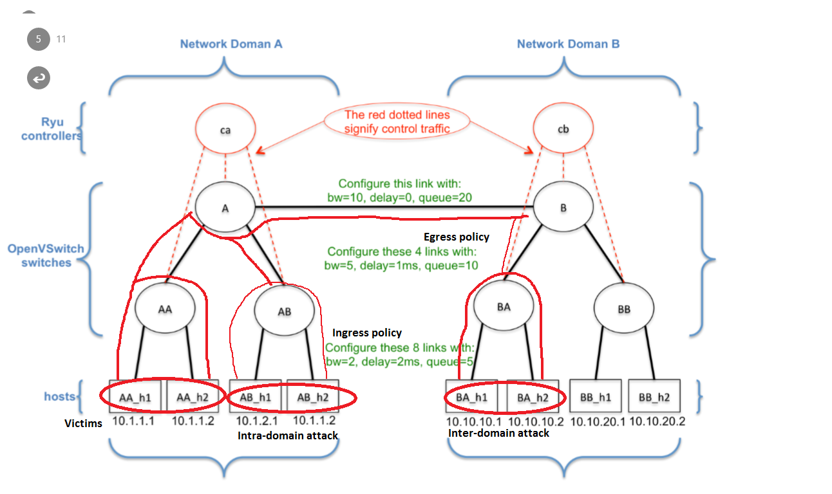
Solution – Egress on pushback
BW : 39 Kbps
BW : 87 Kbps
BW : 6649Kbps
BW : 59 Kbps

Slide 10
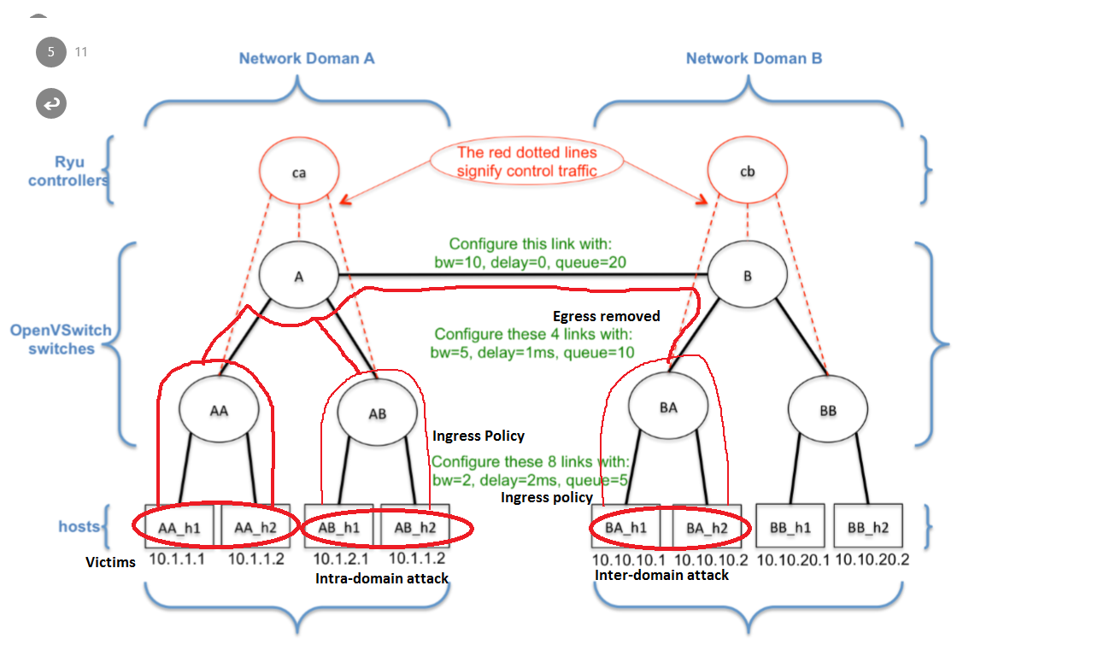
Solution – Ingress on pushback
BW : 120 Kbps
BW : 119 Kbps
BW : 60 Kbps
BW : 59 Kbps

Slide 11
Results
Can detect an arbitrary number of concurrent (hping3) ping flood attacks on one or both of the protected hosts
Response time 10s (5 * 2s query interval)
Attack bandwidth mitigated to < 60 Kbps per attacker
Automatic policy removal after traffic received from attacker < 10 Kbps

Slide 12
Conclusion
Given certain assumptions on the type of expected DDoS attack, SDN proves to be an easy to implement and effective way for mitigation
But: realistic attacks (IP spoofing, fluctuating intensity on different links) provide very complex challenges that could surmount over our mitigation policy.

